Slide 1
DFSS Quarterly Reporting Training
For 2022 reporting

Slide 2
Agenda
Introduction to DFSS Quarterly Reporting requirements
  Requirements
  Sourcing data from HMIS
  Reporting schedule
How to pull DFSS Quarterly Reports from ART
  Accessing the report
  Using reference tables
  Addressing data quality
  Submitting the report
Update on performance metrics by program model for 2022
Questions

Slide 3
Housekeeping
Due to large volume of participants in today's training, all participants are muted.
Please submit your questions using the question function of GoToWebinar.
Information covered in today's webinar will be posted in an article on the HMIS Help Desk. A link will be sent to all ATAs following this webinar.
This webinar will be recorded and included in the Help Desk article.

Slide 4
DFSS Quarterly Reporting Overview
Delegate agencies of the Department of Family and Support Services (DFSS) are required to submit quarterly reports as part of their grant.
Reporting includes information on number of clients served, client demographics and service needs, services provided, and client outcomes. Required data elements vary by program model (e.g., shelter, engagement services, homeless prevention).
DFSS uses this data to:
  Report to funders
  Monitor trends
  Evaluate program results and performance

Slide 5
DFSS Quarterly Reporting Overview (cont'd)
Each program (not agency) supported with DFSS funding is responsible for submitting a quarterly report.
Reports should be emailed in Excel format to Maria LaMothe at maria.lamothe@cityofchicago.org.
  When submitting reports, please identify a back-up contact at your agency for quarterly reporting.
Note that delegate agencies may have additional reporting requirements from DFSS depending on funding sources they receive (e.g., IDHS, ESG, CSBG, CHA). Agencies will receive separate communication from DFSS on these reporting requirements.

Slide 6
Sourcing from HMIS
Beginning in 2019, DFSS partnered with All Chicago to support DFSS delegate agencies in sourcing data for the DFSS quarterly reports from HMIS.
The goals of sourcing DFSS reports from HMIS are to:
  Reduce administrative burden on agencies, and
  Improve the quality of data in our system to help make data-informed decisions
Exception for DV Providers: For agencies that serve survivors of domestic violence as their target population, they will have a DFSS Quarterly Excel template emailed to them.
Projects that use HMIS but for whatever reason do not input data for the project they are reporting on should email helpdesk@allchicago.org.

Slide 7
Reporting Schedule
Two reports are due for each project: Quarterly Entry-Exit and Performance Outcomes report.
Select programs also need to complete an Open Cases report.
  Shelter -January and July Open Cases
  Youth Transitional Housing and Safe Haven - January Open Cases
Reports should be emailed in Excel format to Maria LaMothe at maria.lamothe@cityofchicago.org.
2022 REPORTING SCHEDULE
REPORTING PERIOD | DUE DATE
January - March | April 8, 2022
April - June | July 8, 2022
July - September | October 7, 2022
October - December | January 6, 2023
2022 OPEN CASES REPORTING SCHEDULE
REPORTING PERIOD | DUE DATE
January 1, 2022 Open Cases | March 18, 2022
July 1, 2022 Open Cases (Shelter Only) | August 19, 2022

Slide 8
Quarterly Reporting Changes for 2022
Data elements on the Quarterly Entry-Exit report are consistent with previous years, in line with requirements from DFSS funders.
  For programs previously funded by DFSS as "Emergency Shelters": For 2022, "Emergency Shelter" and "Interim Shelter" program models have been consolidated into one "Shelter" program model. Programs previously funded as “Emergency Shelters” will be required to report on additional metrics in 2022, including client departures.
Metrics on the Performance Outcomes report have been slightly updated for several program models, based on feedback from the latest RFPs.

Slide 9
Agenda
Introduction to DFSS Quarterly Reporting requirements
  Requirements
  Sourcing data from HMIS
  Reporting schedule
How to pull DFSS Quarterly Reports from ART
  Accessing the report
  Using reference tables
  Addressing data quality
  Submitting the report
Update on performance metrics by program model for 2022
Questions

Slide 10
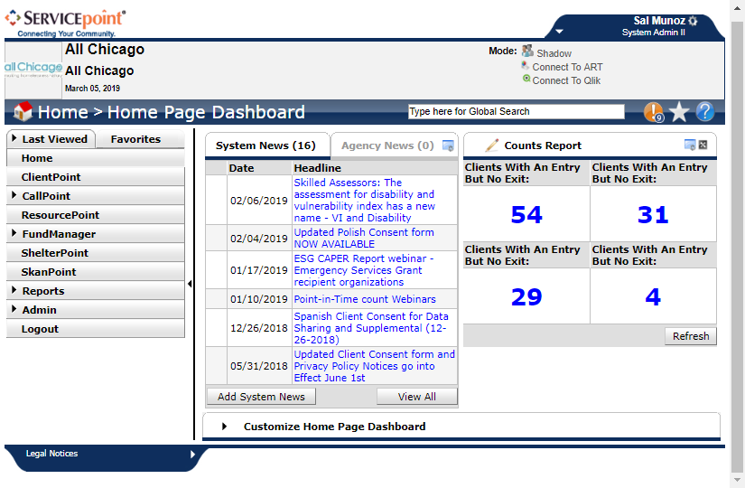

  Accessing The Report
The report will be downloadable only through the Advance Reporting Tool (ART) in HMIS.
This means only Agency Technical Administrators (ATA) or current HMIS users with an ART license will be able to download the report.
If you are unsure who your
ATA is or are not able to
download the report, email
helpdesk@allchicago.org.

Slide 11
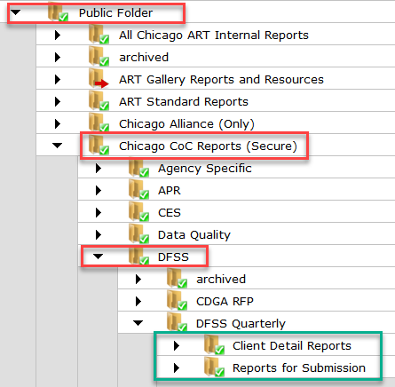
  Accessing The Report
Once in ART, navigate through the following folders:
Public Folder ->
Chicago CoC Reports ->
DFSS ->
DFSS Quarterly

Slide 12
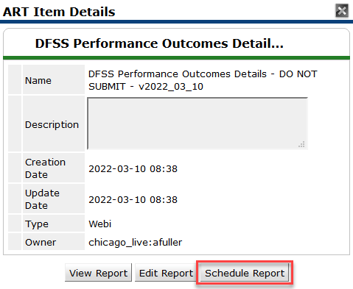
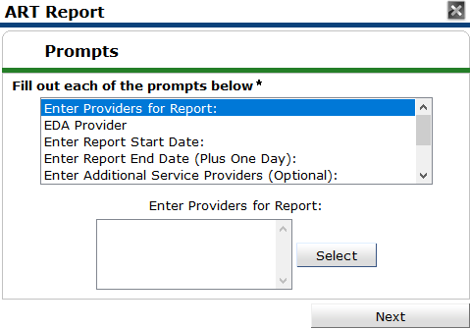
  Scheduling The Report
These reports takes time to process in browser.
The best practice is to schedule the report.

Slide 13
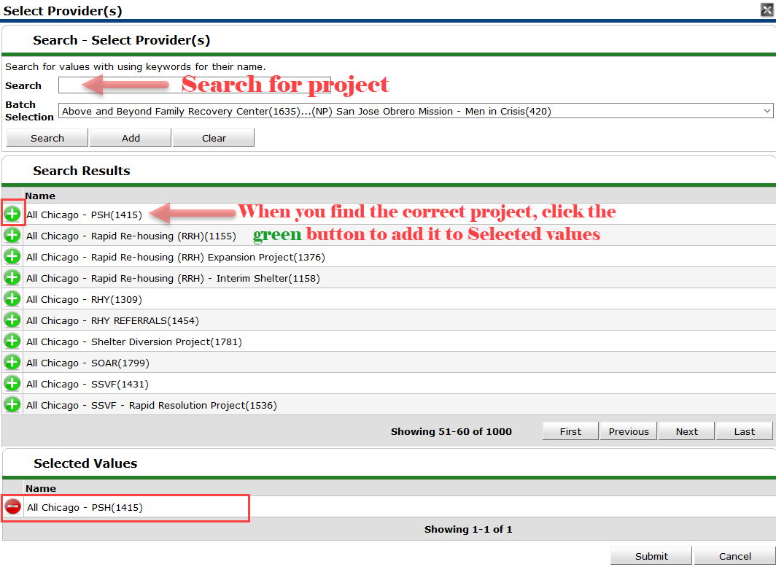
  Scheduling The Report
When you get to this screen:
Search for your project
Select your project by clicking the green button
After selecting the project, it will appear at the bottom
Click submit

Slide 14
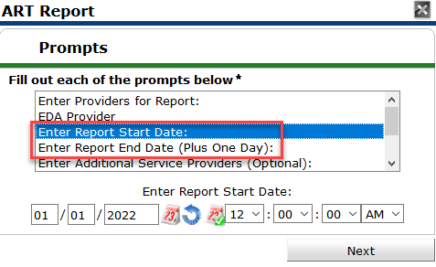
  Scheduling The Report
Date prompts will be prepopulated in the report, but parameters may be updated and entered manually.
Ensure that any reporting range you select for Report Start and End date are in line with the DFSS submission requirements

Slide 15
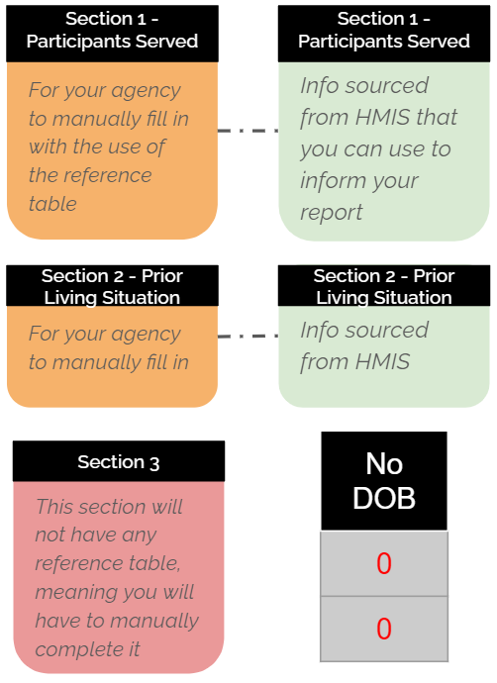
  Using Reference Tables
Green = The table has information that’s sourced from HMIS
Orange = The table requires manual data entry, but you have an HMIS reference table to use
Pink = The table also requires manual data entry, but without the use of a reference table
Grey with Red Text = Missing data, often referencing no date of birth entered
Yellow = Totals

Slide 16
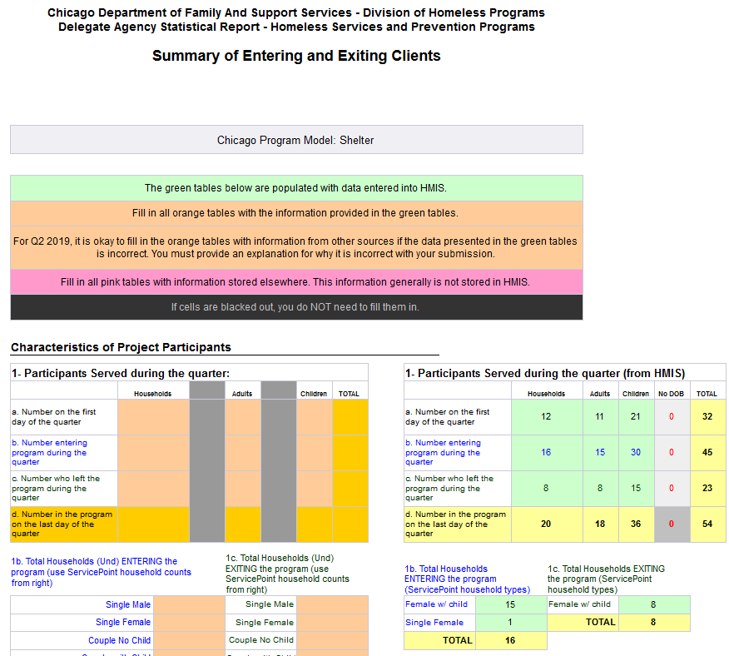
  Using Reference Tables
The Quarterly Report includes the clients you had served that quarter.
There are 13 sections to this report that are then broken down into smaller sub-sections.
Not all program models will have to complete all 13 sections. Your template will reflect what you need to complete.

Slide 17
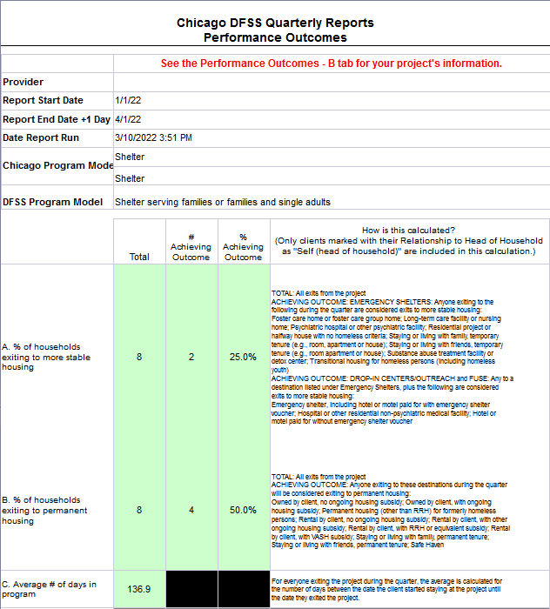
  Using Reference Tables
The Performance outcomes report is due for everyone.
The report will automatically grey out any sections not pertinent to your program type.

Slide 18
  Live Example

Slide 19
  Submitting The Report
Your reports should be saved as an Excel file with your agency and project name, and the type of report it is. The easiest method to name these files will be when you schedule them in ART.
  {Agency}_{Project}_Performance_Outcomes
  {Agency}_{Project}_Quarter_Report

Slide 20
Agenda
Introduction to DFSS Quarterly Reporting requirements
  Requirements
  Sourcing data from HMIS
  Reporting schedule
How to pull DFSS Quarterly Reports from ART
  Accessing the report
  Using reference tables
  Addressing data quality
  Submitting the report
Update on performance metrics by program model for 2022
Questions

Slide 21
Performance Metrics Updates
Many program models had an opportunity to give input regarding performance metrics during last year's RFP process.
  This input was immensely helpful and interesting for us to review, and we thank any organizations that made suggestions in their RFPs!
Based on that RFP input, a desire to align performance outcomes with the COC program models chart, and further internal conversation, there were updates made to performance metrics for a handful of program models.
  Additionally, some program models did not receive changes to required performance metrics for Q1 2022 but may in the future.
Conversation and review of performance metrics for all program models is an ongoing and continually evolving process. If you have any questions or concerns regarding the performance metrics collected for your program model, please do not hesitate to reach out.

Slide 22
Changing 2022 Performance Metrics
Program Model | Program Model Subcategory | 2022 Performance Metrics for Quarterly Reporting | Changes for 2022
Shelter | N/A | Households exiting to more stable housing – total, #, % Households exiting to permanent housing – total, #, % Average # of days in the program % and # of Households with complete CES assessments DV-specific metric: #/% of Households learning about safety planning/the cycle of violence | Added CES metric from the Shelter scope to Q1 reporting.
Frequent Users Service Engagement (FUSE) | N/A | Households exiting to more stable housing – total, #, % Households exiting to permanent housing – total, #, % % of Households that exited to another shelter program. | Added Households that exited metric from the FUSE scope to Q1 Reporting.
Centralized Shelter Intake | N/A | Shelter placement requests completed within 3.5 hours – total, #, % Shelter placement requests completed within 5 hours – total, #, % Well-being checks completed within 3.5 hours – total, #, % Transportation requests completed within 3.5 hours – total, #, % Transportation requests completed within 5 hours – total, #, % | Removed two manual performance metrics that no longer align with the program model from Q1 reports: HHs contacted through outreach efforts accepting one or more basic assistance services (i.e., clothing, transportation, etc.) HHs contacted through outreach efforts connected to community-based case management, housing, or appropriate settings (hospital, family reunification, etc.)

Slide 23
No Immediate Changes to Metrics
Program Model | Program Model Subcategory | 2022 Performance Metrics for Quarterly Reporting | Changes for 2022
Coordinated Entry System Facilitator | N/A | Households assessed for Coordinated Entry – #, % Available units/openings in the Coordinated Entry system that receive a match through HMIS – #, % % of Households enrolled in an outreach or housing system navigation project that have a housing match through CES and move into permanent housing. % of participating agencies (including Applicant and recruited partner agencies) that assess Households or connect Households to entities conducting the CES assessment. | No Immediate changes.
Youth Transitional Housing | N/A | Households exiting to more stable housing – total, #, % Households exiting to permanent housing – total, #, % Average # of days between referral and placement. | No Immediate changes.
Permanent Supportive Housing Supportive Services | PSH | Households who remain housed for 12 months – total, #, % Households assuming the apartment lease or exiting to other independent, stable housing within 2 years – total, #, % | No Immediate changes..
 | Safe Havens | Households who remain housed for 12 months – total, #, % Clients engaged in supportive services – total, #, %
Rapid Rehousing | N/A | Households exiting to more stable housing – total, #, % Households exiting to permanent housing – total, #, % | No Immediate changes.

Slide 24
No Immediate Changes to Metrics
Program Model | Program Model Subcategory | 2022 Performance Metrics for Quarterly Reporting | Changes for 2022
Engagement Services | Outreach/Drop-In | Households exiting to more stable housing – total, #, % Households exiting to permanent housing – total, #, % Households engaged in case management – total, #, % | No Immediate changes.
 | Housing System Navigators | Participants enrolled with system navigators – total, #, % System Navigator enrolled clients permanently housed – total, #, % | No Immediate changes.
Homeless Prevention Assistance | N/A | Clients remaining in permanent housing after crisis intervention – total, #, % Households who remained housed for 12 months – total, #, % | No Immediate changes.
RAP Manager | N/A | % of third-party payments to property owners or their agents made within five business days of receipt from DFSS. % of all assisted units meet HUD habitability standards prior to providing rental assistance. Average # of days before payment is made to property owner or manager. | No Immediate changes.

Slide 25
New Program Model
Program Model | Program Model Subcategory | 2022 Performance Metrics for Quarterly Reporting | Changes for 2022
Diversion | N/A | The % of clients who have a diversion conversation and find an alternative to shelter. The % of clients who find an alternative to shelter and do not return to shelter for 30 days. The % of clients who find an alternative to shelter and do not return to shelter for 60 days. The % of clients who find an alternative to shelter and do not return to shelter for 90 days. Average number of days from check request from client to payment made to property owner/managers. | New Program Model and metrics.
DFSS and All Chicago will follow up with agencies participating in the Diversion pilot with instruction on how to submit all required reports for Q1.

Slide 26
Key Reminders
Please submit reports in Excel format by the deadline to Maria LaMothe at maria.lamothe@cityofchicago.org.
When submitting the Q1 report, please identify a back-up contact at your agency who understands the quarterly reporting process and can respond to any questions from DFSS.
Please email helpdesk@allchicago.org with any questions.

Slide 27
Thank you!

