Slide 1
ATA Meeting
September 12th, 2018

Slide 2
ATA Meeting
Introductions and Welcome
Coordinated Entry
July Quarterly Data Quality Process Results
Proposed Quarterly Data Quality Process Workflow
Training

Slide 3
Thanks to St. Leonard’s Ministries!

Slide 4
New Faces!

Slide 5
Brian Rivera, Senior Manager
Brian joins All Chicago from the Center for Economic Progress, where he was the Senior Innovation Manager for supporting services. Brian brings a wealth of experience with developing and managing web-based systems, supporting end users and online training. Brian graduated from Loyola University Chicago with a degree in Computer Science
Paul Schmitz, Help Desk Coordinator
Paul started his support career at DeVry Education Group, where he created training documentation for their Knowledge base and started a process for knowledge management. Paul also has a Master's Degree in Classical Guitar Performance from the Chicago College of Performing Arts at Roosevelt University.

Slide 6
Coordinated Entry

Slide 7
Let’s take a look at the Dashboard

Slide 8
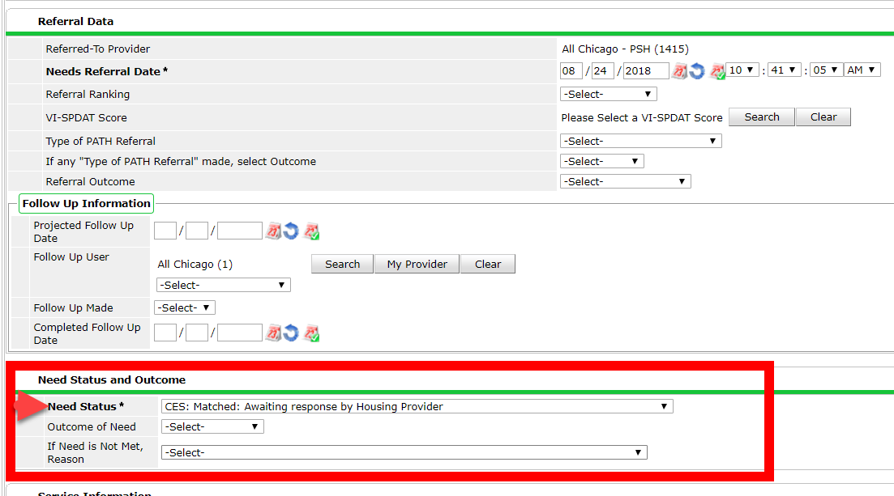
Referral Need Statuses
Number of referral need statuses was reduced from 49 to 36
Reducing the amount of data entry that must be completed for matches
IE. No longer need to indicate when a meeting is scheduled or that you are awaiting eligibility
Article: https://hmis.allchicago.org/hc/en-us/articles/360015454511

Slide 9
Need Statuses
Identified In Progress Closed and Met Closed and Unmet CES: Matched: Awaiting response by housing provider CES: Attempted Contact CES: Client Engaged, Housing System Navigation Needed CES: Enrolled CES: Housed CES: Vouchered: Eligibility confirmed and awaiting unit CES: JBVAMC Only: Housed with VASH CES: Rematch Needed: Client Engaged, Unit no longer available CES: Rematch Needed: Cook County Jail or Juvenile Detention Center CES: Rematch Needed: Client Declined to participate (specify in notes) CES: Rematch Needed: Client Declined: Geography CES: Rematch Needed: Client Declined: Site-Based Youth TH CES: Rematch Needed: Client Declined: Traditional SRO CES: Rematch Needed: Ineligible: Age | CES: Rematch Needed: Ineligible: Criminal Background CES: Rematch Needed: Ineligible: Household Composition CES: Rematch Needed: Ineligible: Income Issue CES: Rematch Needed: Ineligible: Not experiencing homelessness CES: Rematch Needed: Ineligible: Not experiencing CH CES: Rematch Needed: Client located but not engaged in housing process CES: Rematch Needed: Not approved for or received voucher CES: Rematch Needed: Not able to contact client CES: Rematch Needed: Not living in Chicago CES: Rematch Needed: Veteran Status: Not a Veteran CES: Rematch Needed: Veteran Status: Not VHA Eligible CES: Rematch Needed: Other (specify in notes) CES Team Only: Matched for Assessment CES Team Only: System Navigation Matched/Assigned CES: Outreach Team Only: Attempted Contact for Assessment CES: Outreach Team Only: Not able to assess CES: Outreach Team Only: Other (specify in notes) CES: CES Team Only: Individual or household returned to homelessness

Slide 10
Skilled Assessors
Refinement lab wanted to address problems of incomplete/erroneous assessments
A proposed solution from the refinement lab report:
“Reduce the number of Skilled Assessors to a number that provides for reasonable system coverage while still being manageable to achieve quality in the CES”
Impacts:
Emergency Shelters
Outreach Projects

Slide 11
July Quarterly Data Quality Process Results

Slide 12
July Data Quality
Participation:
 | Q2 2017* | Q2 2018 | Difference
Participated and Perfect | 190 | 161 | -29
Not Participated | 72 | 74 | +2

Slide 13
July Data Quality
Primary challenge providers faced with their submission:
 | Q2 2017* | Q2 2018 | Difference
Missing Data | 7 | 6 | -1
Child Only Entries | 4 | 5 | +1
Bed Utilization | 21 | 25 | +4
Timeliness | 40 | 55 | +15
Multiple challenges | 45 | 57 | +12
* Q2 2017 data only looks at data from April - June (2 months)

Slide 14
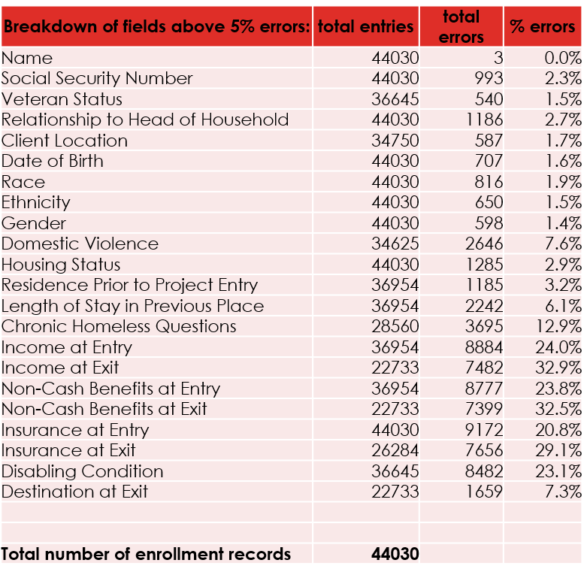
In-depth review of missing data elements
Types of data errors for agencies that submitted
CH and Sub assessments continue to be an area for further improvement

Slide 15
Proposed Quarterly Data Quality Process Workflow

Slide 16
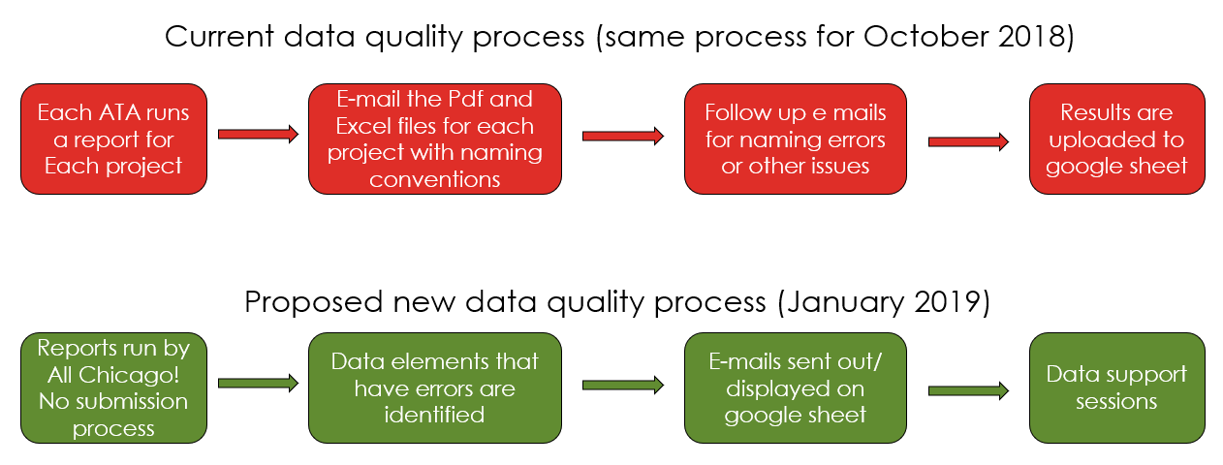
Data Quality Process

Slide 17
Impact of new process
Simplified. Easier. More Efficient.
Data elements that need correction are identified and notifications are sent directly to your inbox
No more submissions! All Chicago runs it for you!
Emphasis of the process is in correcting the data itself instead of on the submission process.
Puts more of a focus on personal relationships through data support sessions

Slide 18
Extended scope
Current data elements:
HUD Universal Data Elements
Entries: Household Composition (Child Only Entries)
Entries: Date Added (Timeliness)
Entries: Bed Utilization
Bed/Unit Lists: Bed Utilization
New data elements:
Exits: Date Added (Timeliness)
Exists: Destination
Entries: Length of Stay (Bed Utilization)
Entries: Overlapping Enrollments (Bed Utilization and Timeliness)
Program Specific Elements by Workflow (SSVF, RHY, PATH, HOPWA)
CES significant fields: Primary Contact Information for ES, TH, SO, SSO, and SH
Housing Move-in Dates: Timeliness

Slide 19
Implementation
Process for implementation:
Create backend programs to run the reports automatically
Send out test e mails to select group of ATAs to get feedback
Provide trainings and webinars to explain the process and understand details of what you can expect from All Chicago
This will be for January 2019 Data Quality process.
Details about exact dates will be mentioned later.

Slide 20
Training

Slide 21
Charges for New User Training begin October 1st, 2018
Format | Fee | Course
Online | No charge | I. Introduction to HMIS
Online | $25 per person per course, beginning October 2018 | II. Project-specific Workflow Track A: ES, TH, SH Track B: PH, PSH, CoC RRH (RRH) Track C: SSVF Track D: ESG RRH Track E: PATH Track F: RHY
In Person | No charge | III. Evaluation

Slide 22
Charges for Coordinated Entry begin October 1st, 2018
Format | Fee | Course
Online | No charge | I. Introduction to HMIS
Online | Two options based on an agency's funding: No charge for HUD funded programs $50 charge for non-HUD/CoC programs and entities | II. CES Skilled Assessor Training
In Person | No charge | III. Evaluation

Slide 23
Courses

Slide 24
Courses
Track A: ES, TH, SH
Track B: PH, PSH, CoC RRH (RRH)
Track C: SSVF
Track D: ESG RRH
Track E: PATH
Track F: RHY

Slide 25
On Time for Rollout
The two courses will be fully available online along with their evaluations sessions:
Track A: ES, TH, SH
Track B: PH, PSH, CoC RRH (RRH)
This means:
Purchased courses will be available online and users will have access to them in perpetuity
Users should be able to get licensed within a week’s turnaround

Slide 26
On Time for Rollout
The following courses will not be readily available online by October 1st
Track C: SSVF
Track D: ESG RRH
Track E: PATH
Track F: RHY
To still provide support for these tracks, we are offering:
Targeted, 4 hour workflow-specific training
Less frequency than that of PH and ES courses
Once the modules are complete, any user that has purchesed them will be given access to the online course for reference

Slide 27
Purchase Courses
Courses can be purchased in two ways
Individual payment
Purchase multiple courses

Slide 28
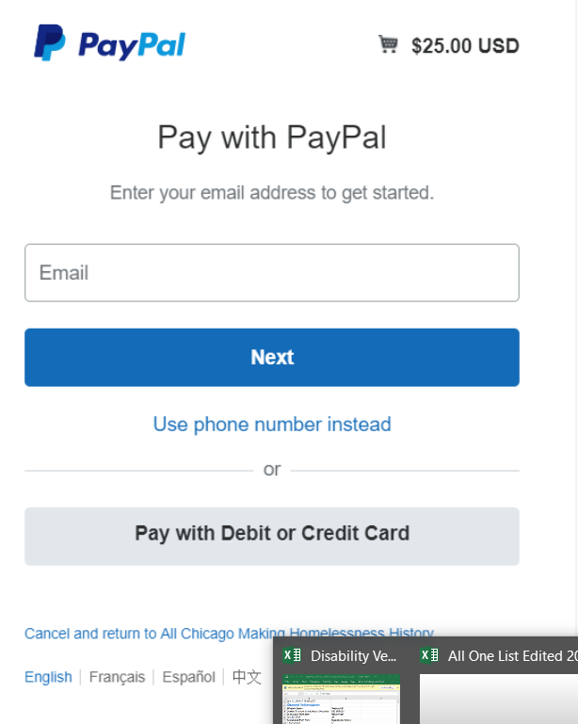
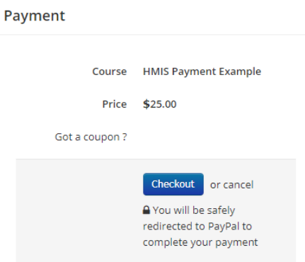
Individual Payment
By Card or PayPal

Slide 29
Bulk Payment
Invoice will be sent to purchasing user
After payment is processed, a coupon code will be created for that agency that will reduce the cost of any given course to zero
A certain number of uses are allocated to each coupon code
In all, the processing time (request to payment) will be about a week before coupon codes are sent.

Slide 30
For more info on processing payment, please see the link below:
https://hmis.allchicago.org/hc/en-us/articles/360013427331-Processing-Your-Payment-for-Training

Slide 31
Handling Erroneous Registrations
If User XYZ started to take the Emergency Shelter course track when they should be taking the Permanent Housing course, notify us and we will switch their credits to the appropriate course.
So long as a course is not fully completed, we can change access to courses

Slide 32
September 14th Online Learning Portal Tour
https://hmis.allchicago.org/hc/en-us/articles/360015346272-Tour-the-HMIS-Online-Learning-Portal

Slide 33
Thank you!

