Slide 1
Point in Time Training
Emergency Shelter

Slide 2
Welcome!
Webinar setup:
Non-presenters are muted
Please use the Questions area to ask questions. We will answer as many in real time as possible. Questions should be available in the left side controls. Click the arrow to expand, type your question in the text area and click Send.
This webinar is not intended to address specific client data situations. Please contact the HMIS Help Desk helpdesk@allchicago.org
The materials and Webinar recording will be made available via a URL link that we will send out

Slide 3
Point In Time Overview
Requirement by Emergency Shelter Type
Shelter Point Vs. Enrollments
Emergency Shelter – Entry/Exit Workflow
Emergency Shelter – Night-by-Night Workflow
Point In Time Report
Additional Data Points to Review
Live Example of Data Review
Helpdesk Links
Questions
Agenda

Slide 4
Point in Time (PIT) Count Overview
Continuums of Care (CoCs) across the country collect information on the number and characteristics of individuals and families experiencing literal homelessness through the PIT Count.
The PIT Count is used to understand trends over time and for planning purposes to allocate federal funds to meet our city's needs. This year the count will be on Thursday, January 23rd, 2025.
Agencies that operate the following project types are required to participate in the count of sheltered persons:
Emergency Shelter – Night-by-Night
Emergency Shelter – Entry/Exit
Transitional Housing
Safe Haven
Identify what projects at your agency are required to participate in the count:
https://hmis.allchicago.org/hc/en-us/articles/11334513999636

Slide 5
Point in Time Overview
Before 2024, projects could provide tally counts and other non-HMIS data for the PIT count.
Starting in 2024, HUD required that HMIS data be used exclusively for HMIS participating projects. This HMIS data via the PIT will also be cross-referenced with other HUD reports for consistency such as the LSA and SPM.
For the 2025 PIT, all HMIS participating projects must have data in HMIS that accurately reflects their bed occupancy (and accurate client enrollments) on 1/23/2025. This may present a challenge for some Emergency Shelter projects.
The purpose of this webinar is to ensure Emergency Shelters are aligned with the HUD data expectations in preparation for the 2025 Point in Time in January.
A more general webinar for the other project types will be held closer to the PIT date. Please make sure to distribute the following materials to your end users.

Slide 6
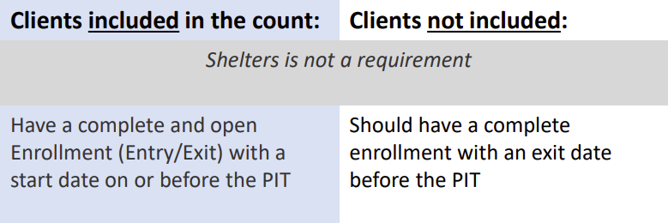
Requirement by Emergency Shelter Type
Emergency Shelter – Entry/Exit
Any agencies that operate an Emergency Shelter – Entry/Exit project will only be required to ensure that their Enrollments (Entry/Exit) are accurate on the day of the PIT.
Emergency Shelter – Night-by-Night
Any agencies that operate an Emergency Shelter – Night-by-Night project will be required to ensure that their Shelter list (ShelterPoint) and Enrollments (Entry/Exit) are accurate on the day of the PIT.

Slide 7
Shelters vs. Enrollments
Projects funded by HUD as Emergency Shelter – Entry/Exit projects are required to have clients enrolled via the Entry/Exit method. Full client records are required at the time of project entry.
Utilizing Shelters for these projects is not a requirement and does not provide any valid data for HUD’s purposes. Projects with an internal workflow that prioritizes Shelter entries over enrollments are likely under-reporting client activity.
Any Emergency Shelter projects that are funded by DFSS are required to complete enrollments for clients via the Entry/Exit method as Quarterly reporting is tied to the values located in enrollment assessments.
Emergency Shelter – Entry/Exit projects that have internal processes/workflows that have prioritized utilizing ShelterPoint over enrollments are encouraged to reach out to Helpdesk@allchicago.org for assistance with making this workflow adjustment.

Slide 8
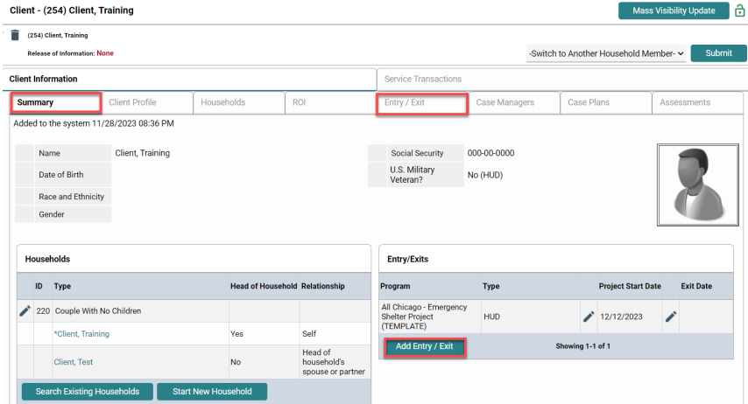
Entry/Exit (Enrollment) Workflow
Navigate to client record
Click Add Entry/Exit through the Summary or Entry/Exit tab
Households: Include other members if necessary
Provider: Select the appropriate project
Type: Select HUD
Project Start Date: The date of enrollment
Save and Continue
Complete the Entry Assessment
Make sure to complete the other Household members’ assessments as well

Slide 9
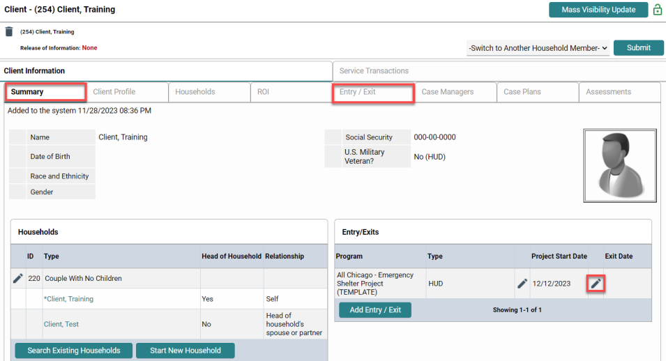
Entry/Exit (Enrollment Exit) Workflow
Navigate to client record
Locate enrollment through the Summary or Entry/Exit tab
Click the pencil icon to the left of the Exit Date column
Include other exiting Household members
Enter exit date, reason for leaving, and exit destination
Complete exit assessment with updates if necessary

Slide 10
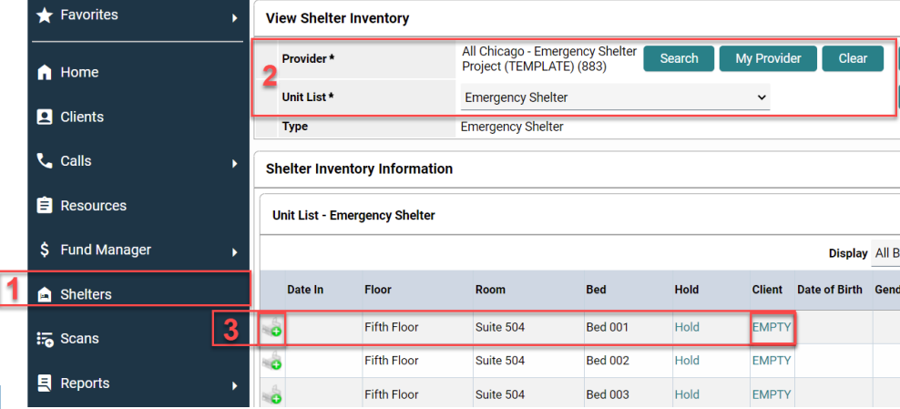
Shelters (formally ShelterPoint) Workflow
To create a Shelters Entry:
Navigate to the Shelters module
Select the relevant provider and unit list
Check Client in
Click the bed icon or the EMPTY link of the desired bed to search for a client
Include other Household members by checking the box and assigning them to a unit
Save and Exit

Slide 11
Shelters (formally ShelterPoint) Workflow
Double check that Household members that should be associated have the same Group ID!

Slide 12
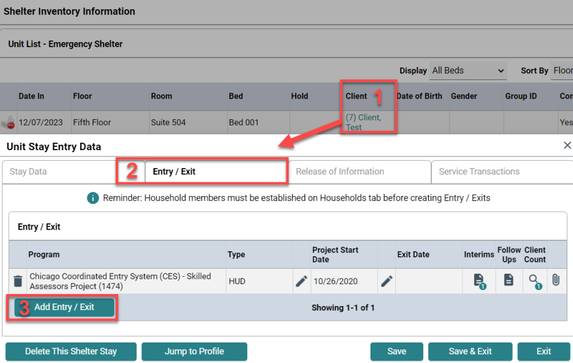
Entry/Exit within Shelters Workflow
This workflow outlines how to add an enrollment within the Shelters module.
After checking a client into a bed,
Open the client’s record by clicking their name under the Clients column of the unit list
Navigate to the Entry/Exit tab
Add Entry/Exit
Complete the Entry Assessment

Slide 13
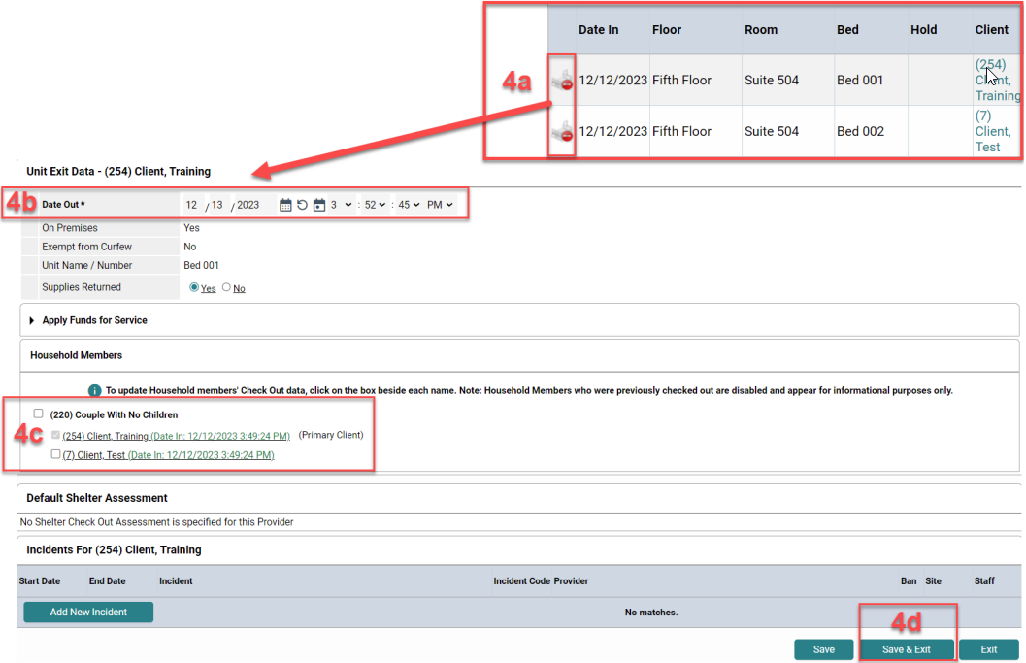
Shelters (formally Shelterpoint) Check out Workflow
To check a client out of a bed:
Navigate to the Shelters module
Select the relevant provider and unit list
Select View All
Check Client Out
Click the bed icon with the red circle of the client that needs to be checked out
Review the date
Check relevant Household members
Save and Exit

Slide 14
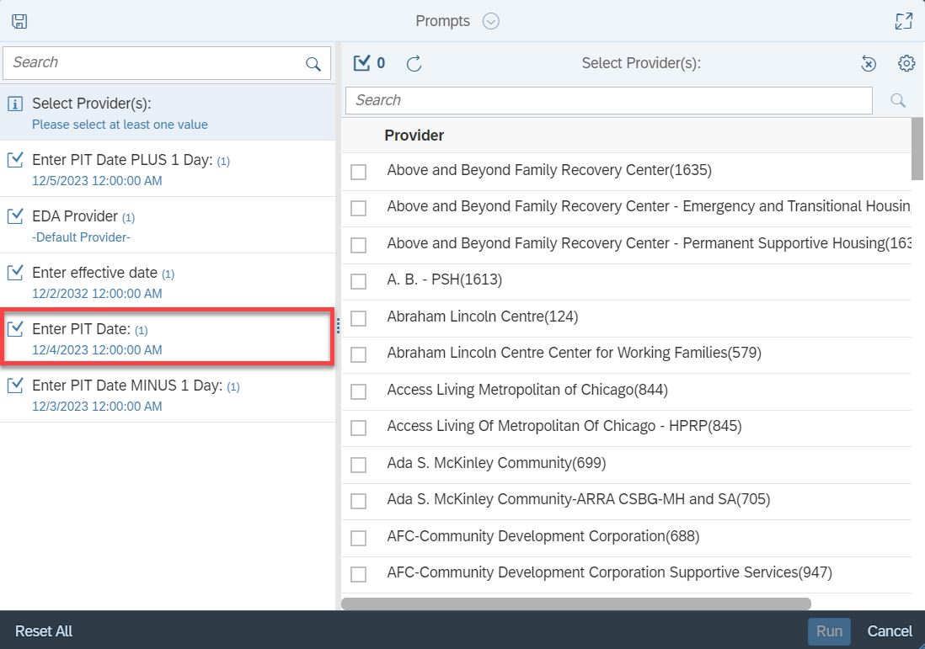
Sheltered Point in Time Report
Emergency Shelter projects can run the Sheltered Point in Time 2024 report via BusinessObjects. This report is designed to operate based on the Emergency Shelter type so depending on the type will determine where the data in the report is pulled from.
We suggest that all agencies become familiar with this report, and do a practice run with a PIT date of your choosing (any date prior to the date you run the report)
The number of clients in the report should match your records for the PIT date selected. Note that changes you make will not be available for reporting until the next day
Notes:
Chicago_live > Chicago CoC > Audit > Point in Time
Describe how to determine dates to check own agency

Slide 15
Sheltered Point in Time Report
A few columns to emphasize when reviewing this report:
Group ID – Make sure that Household members have the same ID number
Exit Date – Clients counted should have: no end date or has an end date on or after the PIT date
All demographic data should be corrected within the Entry Assessment
Veteran Status – This question is the only one in the Client Profile
Disabilities Detail – All Clients with a disabling condition should be included in this list, and mismatched data should be corrected.
Additional Information – Review client counts
Notes:
Run sample report
Add examples

Slide 16
Additional Data Points to Review
In addition to the data point highlighted in the Point In Time report, there are additional review steps providers can take to ensure that data is accurately represented. This can be done by running the Data Quality Report for 1 day.
Prompt Example: Start Date – 12/1/2024 End Date(+1 day) – 12/2/2024
Overlapping /Duplicate Enrollments – A client enrolled in the same project (or project type), where neither enrollment has an end date. This can be within the same agency or outside of your agency.
Example:
Duplicate Clients – A client with more than 1 client ID number. This can usually be identified if both records contain the same First/Last Name, DOB, and/or SS#. In some cases, things might not match 1:1 due to incorrect spelling or missing information.
Example:
Client ID | Project ID | Project Name | Entry Date | Exit Date | Previous Project ID | Previous Project Name | Previous Entry Date | Previous Exit Date
12345 | 883 | All Chicago - Emergency Shelter Project | 2024-07-22 | 2024-08-01 | 883 | All Chicago - Emergency Shelter Project | 2024-07-22 | 2024-07-25
Client ID | First Name | Last Name | Date of Birth | Social Security Number | Project ID | Project Name | Entry Date | Exit Date
589039 | John | Doee | 9/12/1972 | 123-45-6789 | 883 | All Chicago - Emergency Shelter Project | 2024-07-23
569877 | John | Doe | 9/12/1972 | 000-00-6789 | 883 | All Chicago - Emergency Shelter Project | 2024-07-23
Notes:
Run sample report
Add examples

Slide 17
Live Example of Data Review

Slide 18
Resource Links
2025 Point in Time Count Overview
Counts Report – Since Business Objects reports do not reflect real-time data, you may use the Counts Reports in the Dashboard for immediate feedback when completing data corrections.
Other Links
Emergency Shelter LMS Course
Adding an Individual Household Member to an Existing Entry/Exit
Changing an Existing Project Enrollment or Type
Creating/Editing Unit Lists
ShelterPoint Guide

Slide 19
Questions

Slide 20
Thank You
Reminder to please make sure to distribute the following materials to your end users entering data to shelter projects!

