Slide 1
Quarterly Data Quality Process
August 19, 2024

Slide 2
Context
Missing Values / Data Issues
Child-Only Entries
Utilization
Timeliness
Who Participates
Report Details
Overview
Submission Process
Data Quality Timeline
Accessing / Reviewing Report (Live Demo)
Trouble Shooting
Resources / Support
Quarterly Data Quality Process

Slide 3
Context
The Chicago Continuum of Care (CoC) utilizes data-informed approaches to coordinate services and resources in its eﬀorts to end homelessness.
Homeless Management Information System (HMIS) data quality is an important factor to measure eﬀorts to end or prevent homelessness.
The CoC relies on the work of all providers of all funding types to enter accurate, complete, and timely data to ensure we have the information we need to make informed decisions as a community.

Slide 4
Context
Due to this importance on data, and in order to maintain data quality, providers in the HMIS are expected to participate in a quarterly data quality process that addresses data in the following
four areas:
Missing Values / Data Issues
Child-Only Entries
Bed Utilization
Timeliness

Slide 5
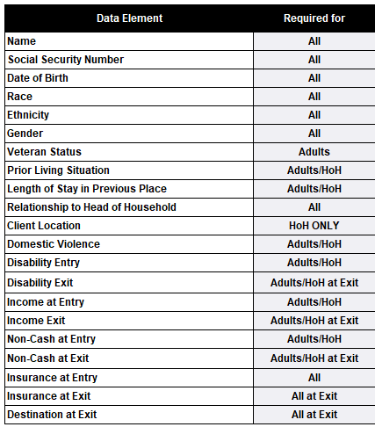
Missing Values / Data Issues
No more than 5% of clients enrolled in the project can miss any data element including the Data Not Collected answer.
Name, SSN, and Date of Birth data elements include Client Doesn’t Know and Client Prefers Not to Answer as Errors.

Slide 6
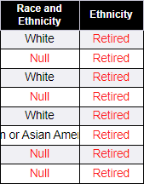
Missing Values / Data Issues
Both Primary Race and Ethnicity fields were retired and replaced during the 2024 Data Standard changes.
Race fields located in the Summary (Tab A) and the Details (Tab B) have been updated and will now be pulled from the new Race and Ethnicity field.
The Ethnicity field has been marked as “Retired” in the Details. Error Percentages for Ethnicity in the Summary have been defaulted to 0%.

Slide 7
Child-Only Entries
There must be zero child-only entries. A child only entry is flagged when a client under the age of 18 is enrolled in a project without being connected to a parent/guardian. This can happen for two reasons:
The child was entered separately from their parent/guardian
The client’s date of birth is missing
If your project serves unaccompanied youth under 18, we ask that you send a ticket to Helpdesk@allchicago.org

Slide 8
Utilization
Bed/Unit utilization must be within the following ranges:
Emergency Shelters: 80%-105%
Transitional Housing: 80% - 105%
Permanent Supportive Housing: 85% - Greater
Safe Haven: 85% - 105%
The utilization for the majority of project types looks at how many clients were enrolled in your project on May 22, 2024, as compared to how many beds/units are indicated in your Bed and Unit Inventory sheet. PSH projects require that clients have a Housing Move-in Date on or prior to May 22, 2024, to be included.
If a project is over/under-utilizing its bed list, but is in compliance for its unit utilization, then the project will still be in compliance. The opposite situation would also count as being in compliance. So long as either bed or unit utilization is in compliance, the project as a whole will be considered compliant.

Slide 9
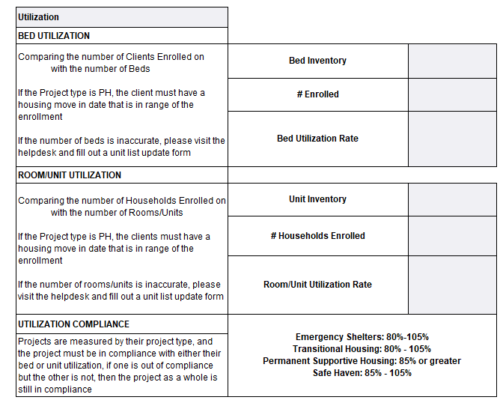
Utilization

Slide 10
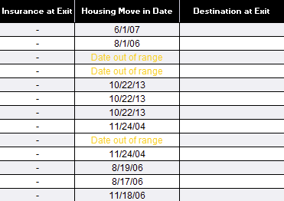
Utilization Change
A Housing Move-in Date column has been added to the Client Details tab so that PSH providers can see which clients are being counted in the utilization table.
PSH clients must have an HMID added that is on or before the PIT date and the HMID is on or after the Entry Date. HMID before the Entry or after the set PIT date (5/22/24) will not be included in the utilization table. They will show on the Client Details tab as "Date out of range“.
"Date out of range“ is NOT always an indication of an error. If the client has a HMID after 5/22/24 they will not be included in the utilization table, but this date should not be changed in HMIS if it’s a valid entry.

Slide 11
Timeliness
Timeliness is tracked through an automated report created by All Chicago. This timeliness report will track the timeliness:
At entry
At exit
At housing move-in dates
For shelter services
Timeliness measures the time it takes to create an element in HMIS. This measure applies even if the entry date is backdated. For instance, if a client originally came into a project on 6/1/2024, but they were not entered into that project in HMIS until 6/4/2024, the information will be considered out of compliance as it took 3 days to indicate that the client was enrolled in the project. Timeliness data cannot be corrected.

Slide 12
Who Participates
All projects, regardless of funding, are required to participate in the quarterly data quality process. So long as a project is active and has at least one client enrolled.
Please refer to the list of currently active projects that are expected to participate in the data quality process.
https://hmis.allchicago.org/hc/en-us/articles/115005062126
If the project does not enter data into HMIS they are not required to participate in the DQ process.

Slide 13
Report Details
Reports must be generated for 1 project at a time
The report will be looking at the period from April 1, 2024, to June 30, 2024
In the report, the point-in-time date is set for May 23, 2024 (PIT Date Plus one day)
This looks at how many clients were enrolled on the night of May 22nd against how many units/beds the project is reported to have
Notes:
S

Slide 14
This Quarter’s Overview
Data Quality process will go from August 19th – August 30th
There will only be one round for submissions. Providers will not need to send in DQ reports until they are ready for final submission.
BusinessObjects reports, which can only be downloaded by users with access to BusinessObjects, will cover the following:
Missing values
Child-only entries
Bed utilization
Changes made in HMIS will not generate in BusinessObjects until the following day.
The SQL report will be sent to ATAs and will cover the following:
Timeliness

Slide 15
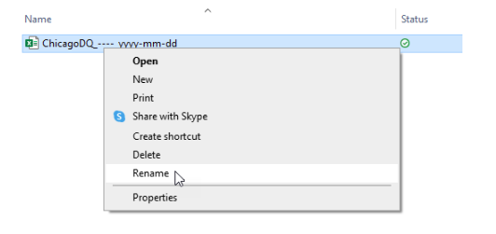
Submission Process
Reports are to be submitted by the August 30th deadline.
Files must be renamed using the ChicagoDQ_----_yyyy-mm-dd template.
Adjust the project ID (----) and the date (yyyy-mm-dd) in the file name before submission
The project ID number in the file name MUST be 4 digits. If a project has less than a 4-digit ID number a "0" should be placed before the ID number in the file name.

Slide 16
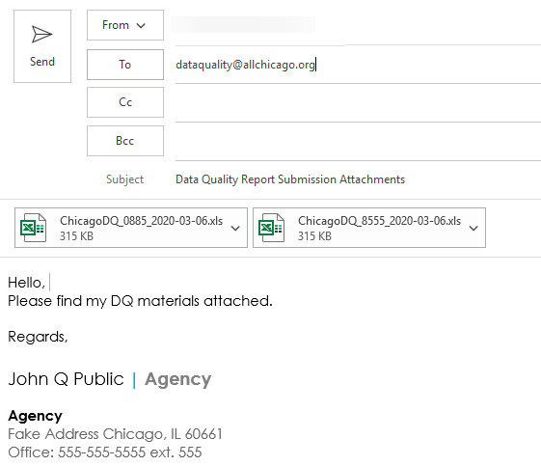
Sending Reports
To submit the Chicago DQ report, please create an email to DataQuality@allchicago.org.
The subject line must be “Data Quality Report Submission Attachments”.
Agencies with more than one project can attach all your data quality reports together in one email, no need to send them separately.

Slide 17
Data Quality Timeline
August 8th
Notice to Community
August 14th
August 19th
Start of DQ Process
August 19th
DQ Webinar
August 19th
August 29th
Correction Period
August 30th
Submissions Due
Final Results Posted

Slide 18
Accessing / Reviewing DQ Report

Slide 19
Troubleshooting

Slide 20
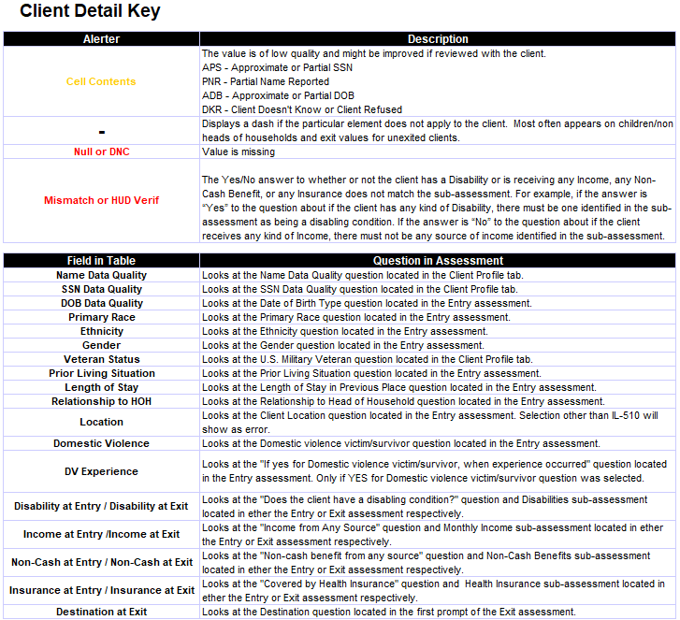
Troubleshooting
Legend can be found on the tab titled Client Detail Key
This key will provide details on the location of questions in HMIS
Name DQ, SSN DQ, and Veteran Status are the only questions that will be found outside of the enrollment assessment. These questions are in the Client Profile.

Slide 21
Resources and User Support

Slide 22
User Resources
We have two articles on the Data Quality process:
Data Quality Process Overview
Running and Interpreting the Data Quality Report
Both articles will have a link to the recorded version of this webinar and slides. Other helpful links
Sub-assessments and HUD Verifications
Documenting the Housing Move-In Date
Relationship To Head of Household

Slide 23
User Resources
We understand there may need to be further training/assistance for users that are new to the process, or that have forgotten how the report process operated.
As such, we are offering assistance through the Help Desk Office Hours (Helpdesk@allchicago.org).

Slide 24
User Resources: Requesting Assistance
All sessions are limited to 30 minutes (This is outside of the typical email exchange.)
Sessions will be done online via Microsoft Teams (please ensure that Teams is available on your computer prior to the call)
An Agency Technical Administrator, or someone with BusinessObject access, must be on the call as well
Please have your report available at the time of the call, or email the report you plan on referencing beforehand

Slide 25
Q & A

Slide 26
Thank you!

