Slide 1
2024 Housing Inventory Count
Survey Training
January 23rd, 2024

Slide 2

Summary & Purpose
Projects Included
Timeline & Submission
Helpful Tips
Survey Section Overview
Section 1 – Section 10
Resources
Questions
Housing Inventory Count
Survey Training

Slide 3
Summary & Purpose
The HIC is a one-night inventory count of projects within the CoC that provide beds and units dedicated to serving persons who are homeless. It is intended to provide HUD and the CoC with information about the shelter and housing capacity of homeless crisis response systems. It should reflect the number of beds and units available for occupancy on the night of the PIT count.
Purpose
Contributes to accuracy in the LSA
Bed and Unit inventory utilized for Coordinated Entry
A component of the CoC’s annual NOFO application
Informs the system’s decisions with data

Slide 4
Who Needs to Submit a HIC Survey
For the HIC, a project with dedicated beds/units is one where:
The primary intent of the project is to serve homeless persons
The project verifies homeless status as part of its eligibility determination
The actual project clients are predominantly homeless (or, for permanent housing, were clients are homeless at entry).
HUD Project Types included in the HIC:
Emergency Shelter (ES) (Entry/Exit and Night-by-Night)
Transitional Housing (TH)
Safe Haven (SH)
Permanent Housing (PH)
  Permanent Supportive Housing (PSH)
  Rapid Re-housing (RRH)
  Other Permanent Housing
    Permanent Housing – Housing with Services (no disability required)
    Permanent Housing – Housing Only

Slide 5
Timeline & Submission
January 25, 2024 - HIC survey opens (https://survey.alchemer.com/s3/7684572/2024-HIC-Survey)
January 30, 2024 – All Chicago will send out reminders to providers
February 9, 2024 - HIC survey closes
Submission
A separate HIC survey must be completed for each required project within your agency.
All surveys must be completed and submitted via Alchemer. PDF submissions will not be accepted
Housing Inventory Count Reference Table
https://hmis.allchicago.org/hc/en-us/articles/12451585191956-2023-Housing-Inventory-Count-Reference-Table
All providers, both participating and non-participating must submit surveys no later than 11:59 PM on Friday, February 9, 2024

Slide 6
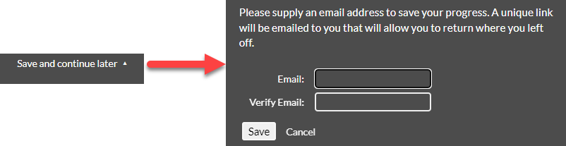
Helpful Tips
Have project information available prior to completing the survey
Review the PDF version on our Workflow helpdesk article to understand all the questions being asked
Survey allows the opportunity to Save and continue later via the drop-down icon in the top right corner of the survey

Slide 7
Survey Section Overview
The HIC survey will ask projects to verify data found in HMIS or that was reported in
the 2023 HIC. Projects will affirm, or update, data relating to the following elements
of your project(s):
Section 1: Project Information
Section 2: Inventory in Development
Section 3: Project Type
Section 4: Target Population
Section 5: Units
Section 6: Beds
Section 7: Emergency Shelter Beds (ES types only)
Section 8: Permanent Supportive Housing Dedicated Beds (PSH only)
Section 9: HMIS Participation
Section 10: Night of January 25, 2024 (Non-Participating and PH project types only)

Slide 8
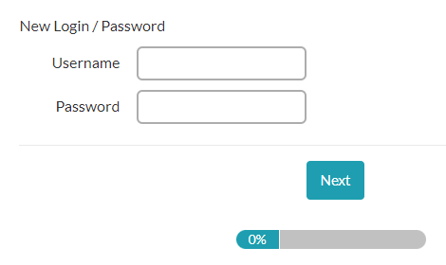
Logging into the Survey
You will only need the project’s HMIS ID to log in. The HMIS ID will
act as the Username and Password.
Username: HMIS Project ID
Password: HMIS Project ID
Example: (883) All Chicago - Emergency Shelter
Username: 883
Password: 883

Slide 9
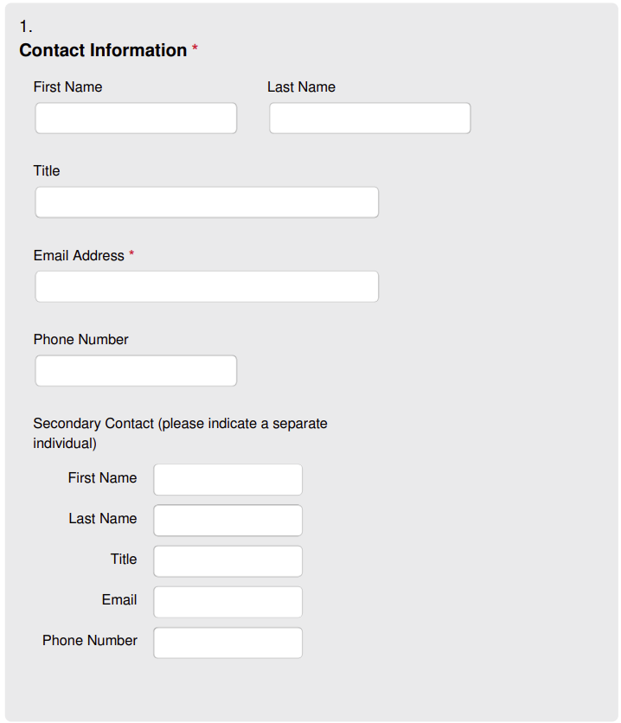
Section 1: Project Information
Primary Contact
Email addresses added for primary contact will be used for submission confirmations.
Secondary Contact

Slide 10
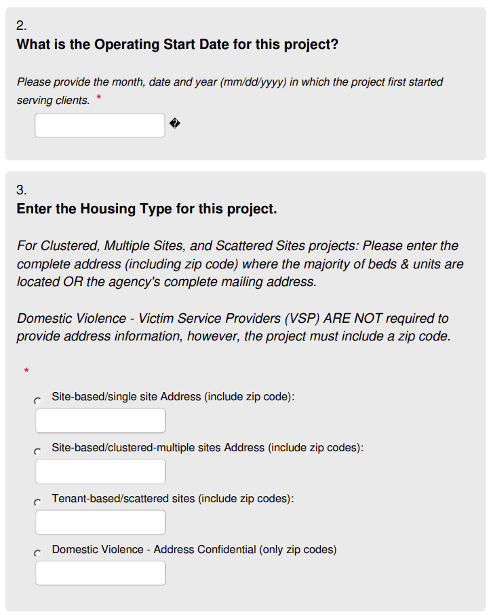
Section 1: Project Information
The operating Start Date is when the project first started serving clients
If your project has an End Date that has passed, please see Project Deactivation Article
For the Housing Type question, if you select any housing type besides ‘Site-based/single site Address’, you will be asked to also select the zip codes your project operates in.
If you are an RRH Provider, to the best of your ability, please report all the zip codes your project operates in

Slide 11
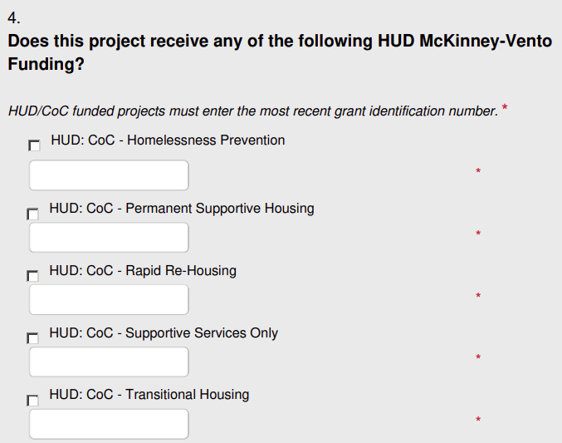
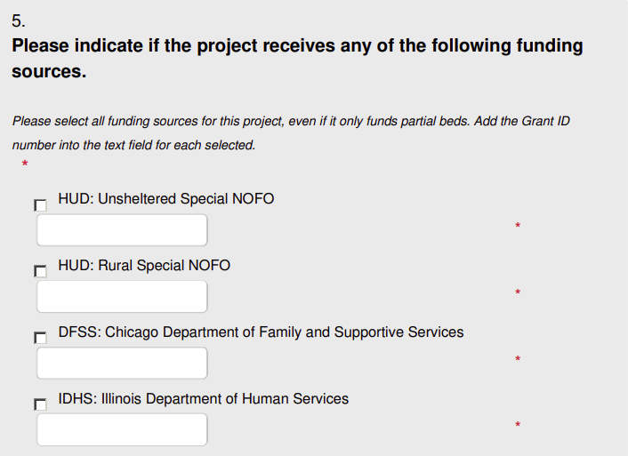

Section 1: Project Information
Be sure to include the Grant Identification Number or Award ID for each funding source selected

Slide 12
Section 2: Inventory in Development​
If your project’s number of beds or units will or did increase between February 1, 2023, and January 25, 2024, your inventory will be considered ‘Current’.
Current Beds/Units:
Any beds or units available for occupancy on the night of January 25, 2024.
Under Development Beds/Units:
Any beds and or units fully funded and available for occupancy by January 31, 2024, not operating now.

Slide 13
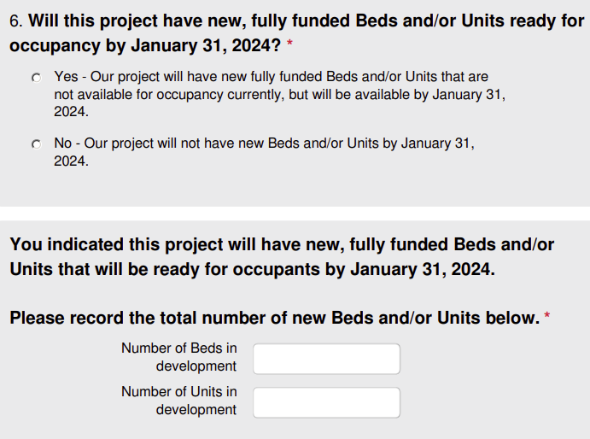
Section 2: Inventory in Development​

Slide 14
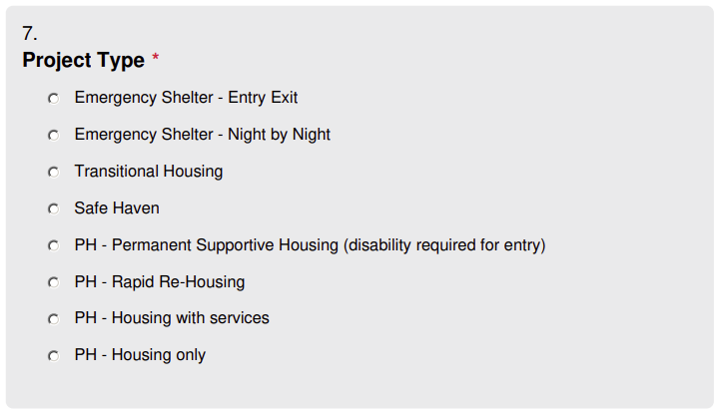
Section 3: Project Type
The Project Types included are based on the most recently published 2024 HMIS Data Standards
This section is important to complete. Depending on the Project Type selected, the survey will populate additional questions needed for the HIC.

Slide 15
Section 4: Target Population
Projects can indicate a ‘Target Population’ if they meet the following two criteria:
The project intends to serve that specific population
At least 75% of the clients served by the project fit the target group descriptor
Only one Target Population may be selected per project. If the project doesn’t serve a Target Population, indicate N/A.

Slide 16
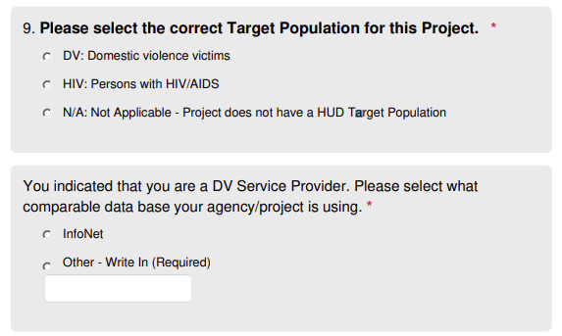
Section 4: Target Population
DV providers will be required to select if you use InfoNet, or report on an alternate comparable database at your agency.
HUD is requiring that we report this information via the HIC.

Slide 17
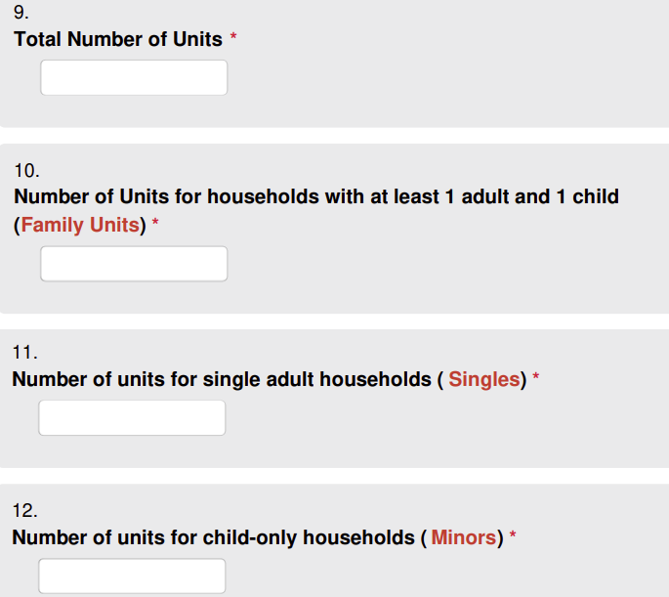
Section 5: Units
Unit:
Units should be viewed as the count of households that can be served. If the project is serving Single clients, then the Unit and Bed inventory
Must be 1:1
If Units are unavailable for a particular household type 0 should be added to the text field

Slide 18
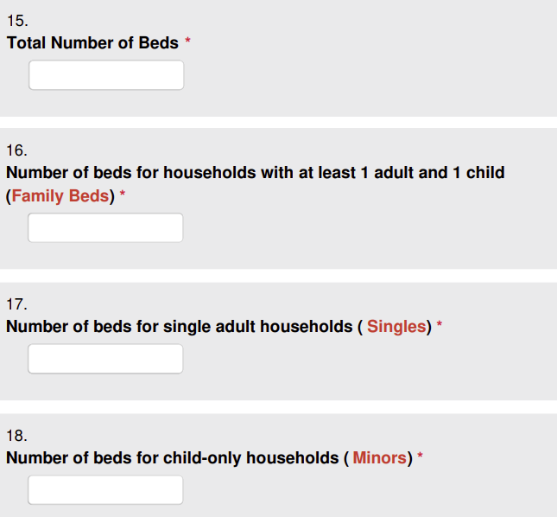
Section 6: Beds
Beds:
Beds should be viewed as the count of individual clients that can be served. If the project is serving
Families then the Unit and Bed inventory Can Not be 1:1
If Beds are unavailable for a particular household type 0 should be added to the text field

Slide 19
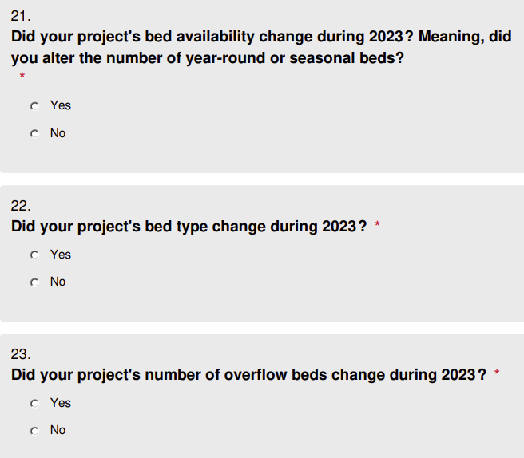
Section 7: Emergency Shelter Beds
(ES types only)
This section applies to both Emergency Shelter Entry/Exit and Night-by-Night HUD Types.
Each ES project must indicate the Bed Type, Bed and Unit Availability as well as Overflow Beds. If Type or Availability has changed, you will be asked to provide the current information.

Slide 20
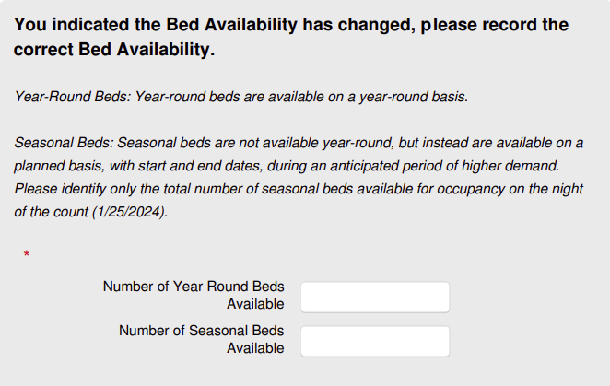
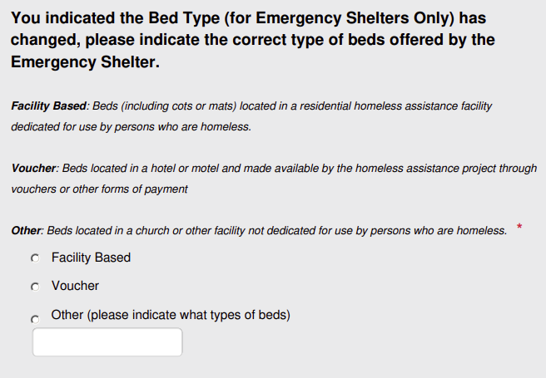
Section 7: Emergency Shelter Beds
(ES types only)

Slide 21
Section 8: Permanent Supportive Housing Dedicated Beds (PSH only)
As of October 2019, HUD updated national HMIS data standards and altered the definition of Dedicated Beds and how they are reported.
Now, all beds funded by HUD or another Federal Partner dedicated to the listed populations below must be reported as Dedicated Beds. These categories are now:
Chronic Homeless Veterans
Youth Veterans
Any Other Veterans
Chronically Homeless Youth
Any Other Youth
Any Other Chronically Homeless Individuals

Slide 22
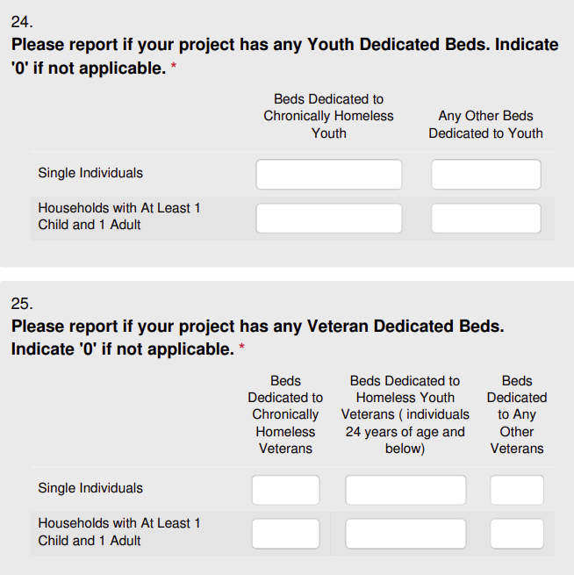
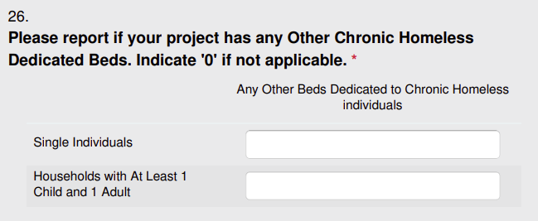
Section 8: Permanent Supportive Housing Dedicated Beds (PSH only)
The total dedicated bed count (cumulative total of questions 24 through 26) should not exceed the total bed count for question 15 on the survey.

Slide 23
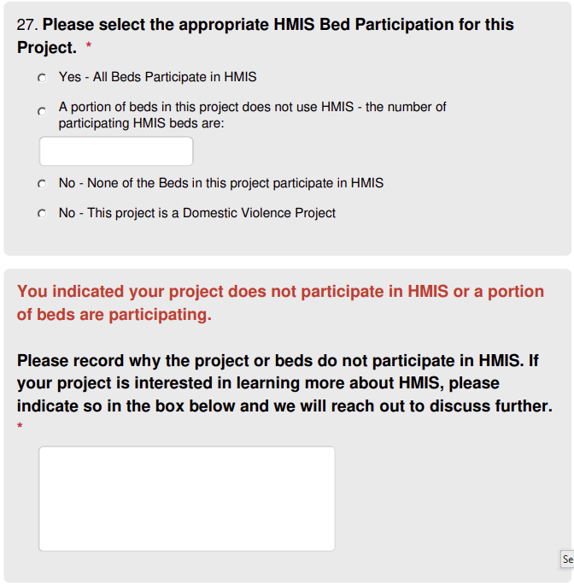
Section 9: HMIS Participation
HMIS Bed Participation: Projects that make a reasonable effort to record all universal data elements on all clients served in those beds and disclose that information through the Data Quality process.
If a project is separated into two HMIS projects; participating HMIS beds/units and non-participating beds/units already, indicate ‘Yes’ that all beds are participating.
If you indicate non-participating, additional questions will be required

Slide 24
Section 10: Night of January 25, 2024
(Non-Participating and PH project types only)
Unit/bed occupancy and utilization within this project on the night of January 25, 2024. Before completing this section, PH providers should have generated a Utilization BusinessObjects report. This report will assist in answering the following questions, as it will provide data on the occupancy and utilization captured on January 25, 2024.
Non-Participating Projects will complete the survey based on their internal data from the night of January 25, 2024.

Slide 25
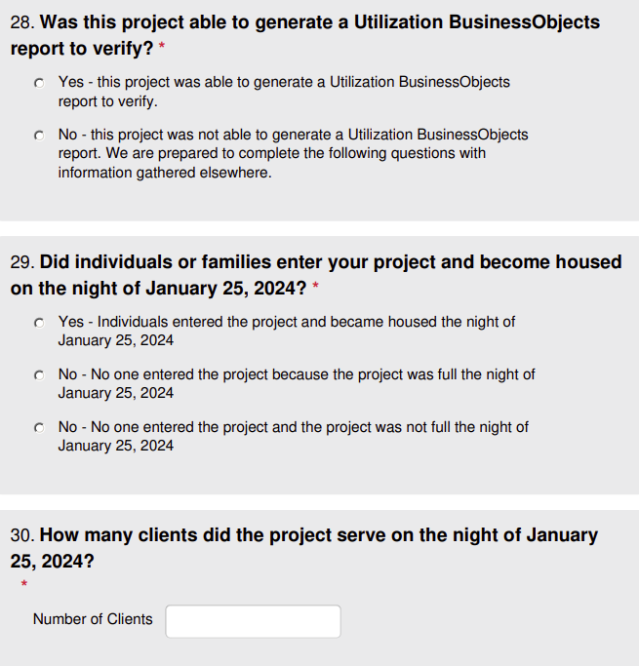
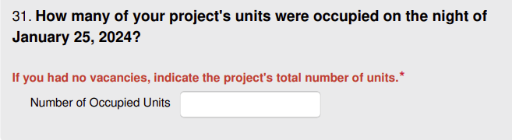
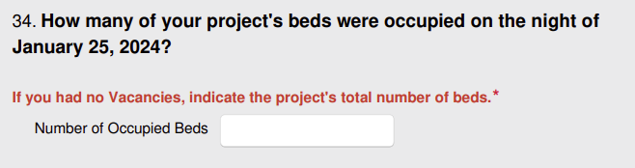
Section 10: Night of January 25, 2024
(Non-Participating and PH project types only)

Slide 26
Resources
2024 Housing Inventory Count Process Overview
https://hmis.allchicago.org/hc/en-us/articles/12222405120020
2024 Housing Inventory Count Workflow
https://hmis.allchicago.org/hc/en-us/articles/12423562674452
2024 Housing Inventory Count Reference Table
https://hmis.allchicago.org/hc/en-us/articles/12451585191956
Generating and Interpreting the Utilization Business Objects Report
https://hmis.allchicago.org/hc/en-us/articles/12483136629524
For any questions, please reach out to Helpdesk@allchicago.org

Slide 27
Timeline & Submission
January 25, 2024 - HIC survey opens (https://survey.alchemer.com/s3/7684572/2024-HIC-Survey)
January 30, 2024 – All Chicago will send out reminders to providers
February 9, 2024 - HIC survey closes
Submission
A separate HIC survey must be completed for each required project within your agency.
All surveys must be completed and submitted via Alchemer. PDF submissions will not be accepted
Housing Inventory Count Reference Table
https://hmis.allchicago.org/hc/en-us/articles/12451585191956-2023-Housing-Inventory-Count-Reference-Table
All providers, both participating and non-participating must submit surveys no later than 11:59 PM on Friday, February 9, 2024

Slide 28
Questions

