Slide 1
Agency Technical Administrator (ATA) Team Meeting
March 29th

Slide 2
Ending Veteran Homelessness Initiative
Ending Veteran Homelessness Initiative
One List (remaining to be housed) – Current as of 3/28/16 | 833
Total Housed from 1/1/15 – 2/29/16 | 1996

Slide 3
Ending Veteran Homelessness Initiative

Slide 4
Ending Veteran Homelessness Initiative

Slide 5
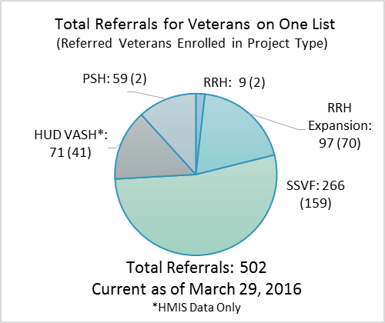
Ending Veteran Homelessness Initiative
Connecting Veterans to PSH – the sole use of HMIS instead of the Central Referral System

Slide 6
Zero:2016 Ending Chronic Homelessness

Slide 7
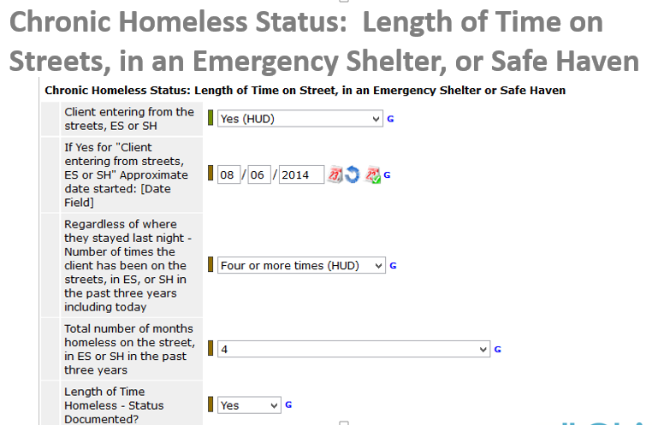
Zero:2016 Ending Chronic Homelessness

Slide 8
Zero:2016 Ending Chronic Homelessness
Date started: Enter the actual or approximate date the client started staying in their homeless situation from which they entered your project

Slide 9
Zero:2016 Ending Chronic Homelessness
Date Started

Slide 10
Total number of months homeless on the street, in ES or SH in past three years

Slide 11
How HMIS Can Help
A Policy and Procedure is being created to allow the use of HMIS to document chronic homelessness history.
Project Type
Project Entry and Exit Date
Evidence of Breaks
*HMIS cannot be used to document disability status

Slide 12
Point in Time Count (PIT)
Use of HMIS to gather Sheltered PIT Data – Overview
Feedback and suggestions from agencies that participated in the Sheltered PIT via HMIS
Additional comments or questions about the PIT process

Slide 13
Quarterly Data Quality Assessment Process:

Slide 14
Quarterly Data Quality Assessment Process:

Slide 15
Quarterly Data Quality Assessment Process: Missing Data Rates for Submitted Reports

Slide 16
Quarterly Data Quality Assessment Process: Bed Utilization

Slide 17
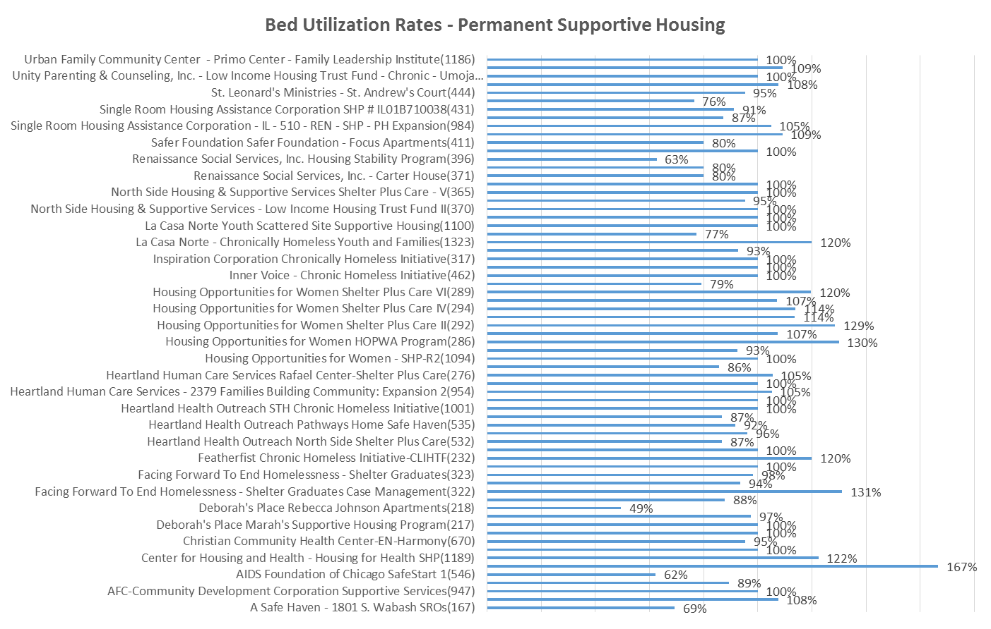
Quarterly Data Quality Assessment Process: Bed Utilization

Slide 18
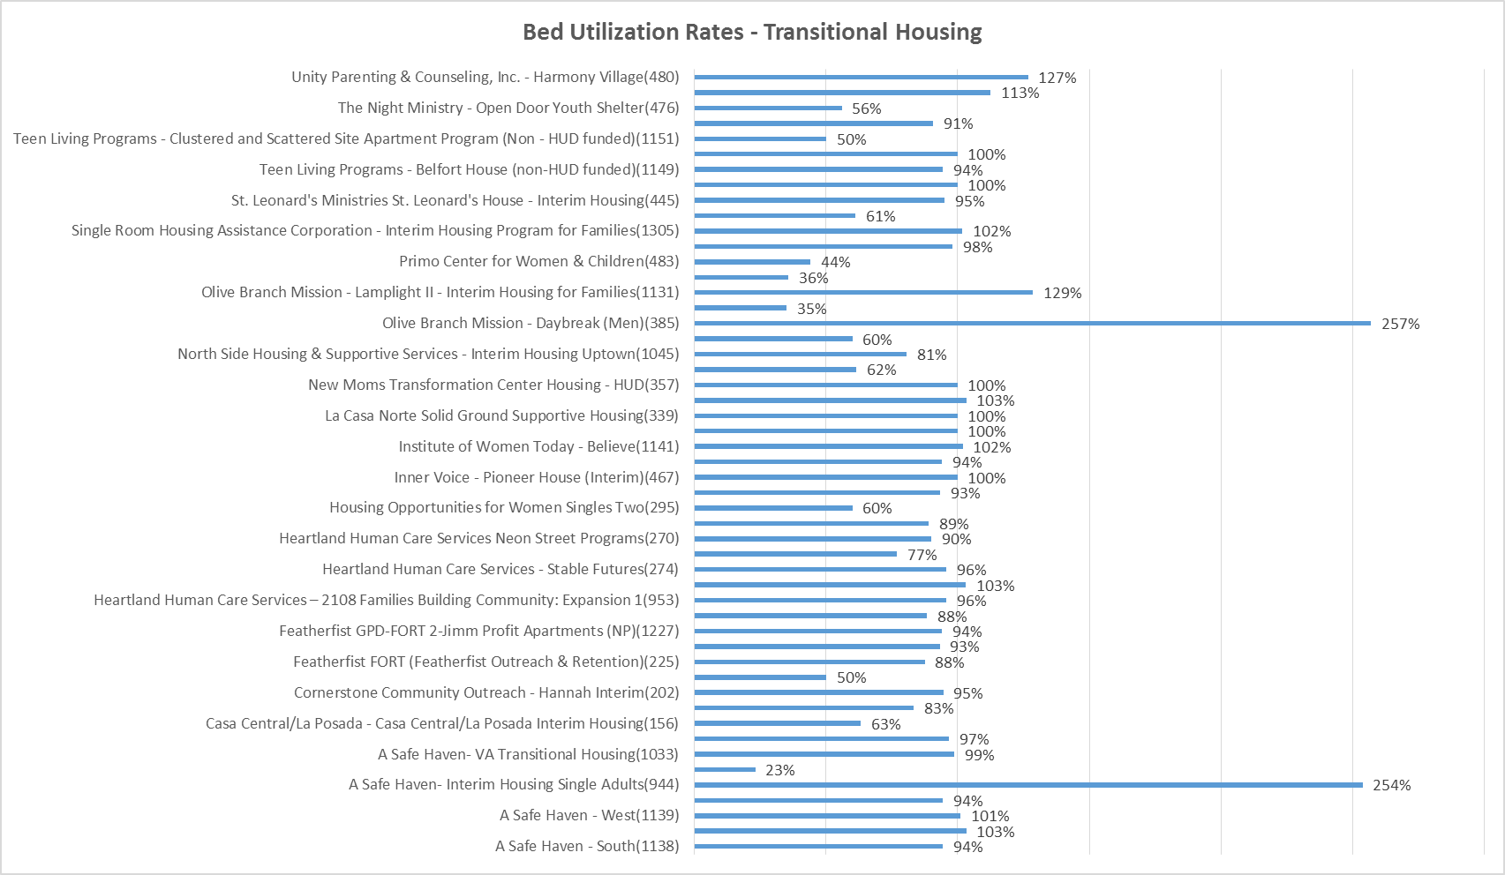
Quarterly Data Quality Assessment Process: Bed Utilization

Slide 19
Quarterly Data Quality Assessment Process:
Assessment | Timeliness Requirements | Bed Utilization Requirements
Jun-16 | 50% of entry records and shelter stay services recorded between Apr 1 and May 31 2016 must be entered within the established deadlines for compliance | Projects outside established bed utilization ranges on the last Wednesday in Apr 2016 will be considered out of compliance unless they provide a statement that the number enrolled in HMIS is accurate
Oct-16 | 75% of entry records and shelter stay services recorded between Jun 1 and Sept 30 2016 must be entered within the established deadlines for compliance | Projects outside established bed utilization ranges on the last Wednesday in Jul 2016 will be considered out of compliance unless they provide a statement that the number enrolled in HMIS is accurate
Jan-17 | 85% of entry records and shelter stay services recorded between Oct 1 and Dec 31 2016 must be entered within the established deadlines for compliance | Projects outside established bed utilization ranges on the last Wednesday in October 2016 will be considered out of compliance unless they provide a statement that the number enrolled in HMIS is accurate
Apr-17 | 95% of entry records and shelter stay services recorded between Jan 1 and Mar 31 2017 must be entered within the established deadlines for compliance | Projects outside established bed utilization ranges on the last Wednesday in Jan 2017 will be considered out of compliance unless they provide a statement that the number enrolled in HMIS is accurate

Slide 20
Quarterly Data Quality Assessment Process:
Project Type | Timeliness Requirement
Emergency Shelters and Interim Housing | Data entered within 3 days of entry/shelter stay
All others | Data entered within 7 days of entry/shelter stay
Project Type | Acceptable Bed Utilization
Emergency Shelters | 80%-105%
Interim Housing | 80%-105%
Transitional Housing | 80%-105%
Permanent Supportive Housing | 85%-105%
Safe Haven | 85%-105%

Slide 21
Thank you!
Next Meeting
Wednesday, May 11th
10am - Noon

Slide 22
Content
Content
Content
Content
Content
Content

